Slide 1
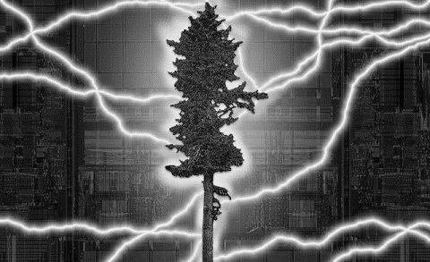

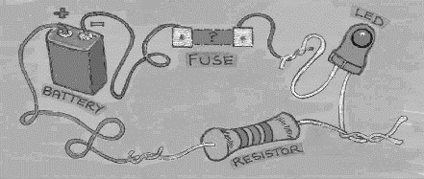
EHB222E QUESTIONS

Slide 2
Find the source voltage V_{s}
Answer: 40V

Slide 3
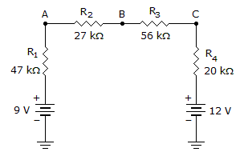
Calculate the voltage at point B in the given circuit.

Slide 4
If you put an infinite number of resistors in parallel, what would the total resistance be?
Answer:
0 Ohm

Slide 5
Calculate I_{x} value?
Answer:

Slide 6
Calculate current values. I₄=4A
Answer:

Slide 7
Calculate current values. V_{S}=4V
Answer:

Slide 8
Calculate current and resistor values

Slide 9
What is a semiconductor? How does a semiconductor differ from a conductor? Explain within two sentences.
Answer:
The basic differences are
a. There are two types of charged carriers in semiconductors, electrons and holes, respectively, whereas conductors only have electrons.
b. Electrons can freely move within conductors whereas in semiconductors they have to pass an energy gap.

Slide 10
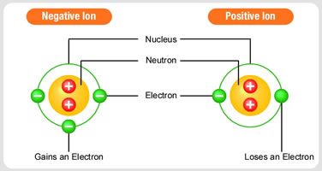
An n-typed material has holes and negatively charged ions. True or false?
N
Answer:
False
SI
N
SI
SI
SI
SI
SI
SI
SI
SI

Slide 11
In an n-typed material, the donor atom density is 10e17 atoms/cm3. What is free electron density?
Answer:
10e17
N
SI
N
SI
SI
SI
SI
SI
SI
SI
SI

Slide 12
Calculate the amount of charce that is stored on the capacitor.
Answer:
We know that under DC conditions the capacitor appears as an open circuit (no current flowing through it). Therefore the corresponding circuit is

Slide 13
Calculate the amount of charce that is stored on the capacitor.
Answer:
We know that under DC conditions the capacitor appears as an open circuit (no current flowing through it). Therefore the corresponding circuit is
From this circuit we see that the voltages v1 and v2 are both equal to 10 Volts and thus the voltage across capacitor C1 is 0 Volts. The voltage across capacitors C2 and C3 is 10V.

Slide 14
DIODE QUESTIONS

Slide 15
A p-n diode is modeled with the exponential model. The diode currents are measured 1.36 mA and 7.20 mA when 0.7 V and 0.75 V applied, respectively. Determine the saturation current I_{S} and the emission factor n (from nV_{T}). Suppose that V_{T} = 25 mV.

Slide 16
Find the values of I and V for the circuits shown. Use the ideal I-V model for diodes.

Slide 17
Find the current and voltage values of the Zener diodes I_{D1}, V_{D1}, I_{D2}, and V_{D2}. Use the constant drop model, shown in Figure 2, for Zener diodes.

Slide 18
Use a constant drop model for the Zener diode in Figure 1. The model has 0,7 V forward bias and 2V Zener (V_{Z}=2V) voltage. An input signal, shown in Figure 2, is applied. Sketch V_{o}, i_{D1} and i_{D2} in time domain. Justify your answer.

Slide 19
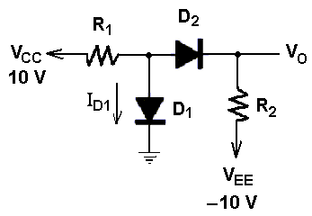
In figure, assume modified diode model (V_{D}=0.7V) for the diodes.
a) Calculate I_{D1} and V_{O} for R1=5 kΩ, R2=10 kΩ.
b) Calculate I_{D1} and V_{O} for R1=10 kΩ, R2=5 kΩ.

Slide 20
BJT QUESTIONS

Slide 21
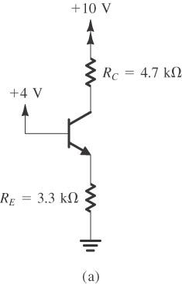
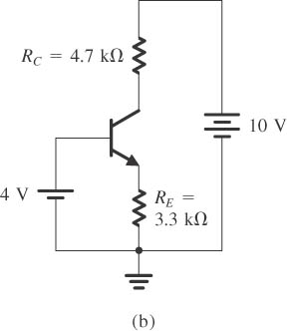
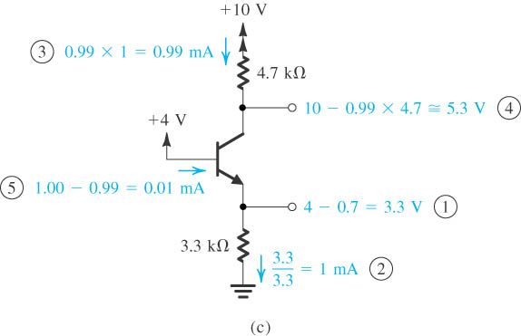
Analysis of the circuit : (a) circuit; (b) circuit redrawn to remind the reader of the convention used in this book to show connections to the power supply; (c) analysis with the steps numbered. (β = 100 (active mode), V_{BE} = 0.7V)

Slide 22
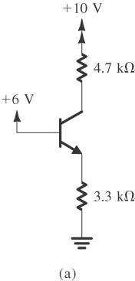
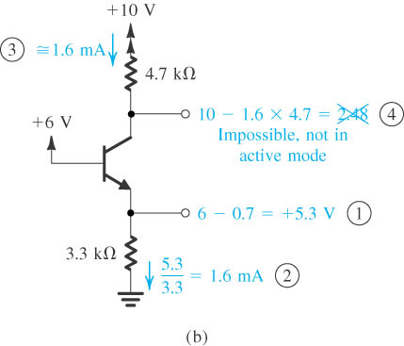
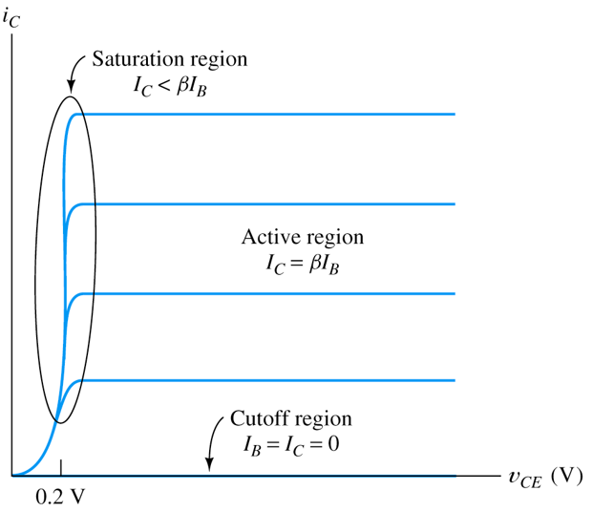
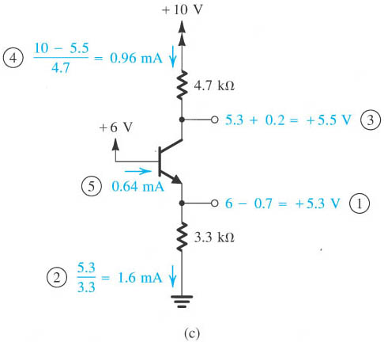
Analysis of the circuit. Note that the circled numbers indicate the order of the analysis steps. ( β = 100 (active mode) , V_{BE} = 0.7V)

Slide 23
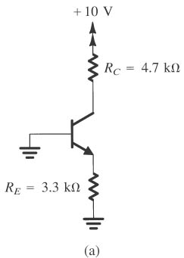
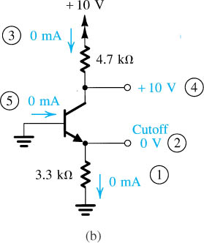
Example: (a) circuit; (b) analysis with the order of the analysis steps indicated by circled numbers.

Slide 24
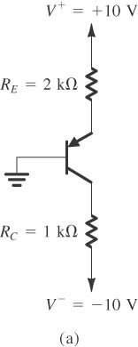
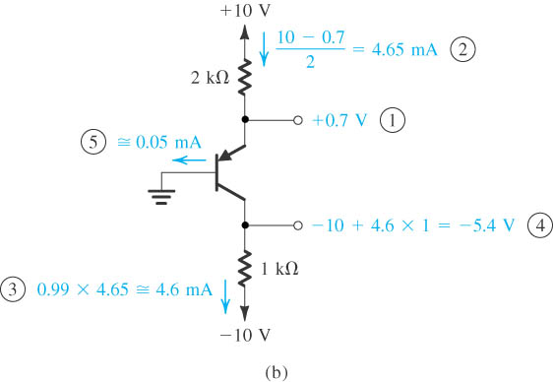
Figure (a) circuit; (b) analysis with the steps indicated by circled numbers. ( β = 100 (active mode) , V_{BE} = 0.7V)

Slide 25
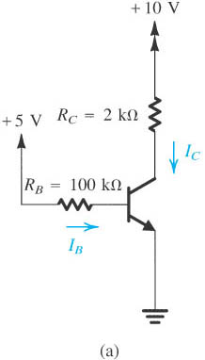
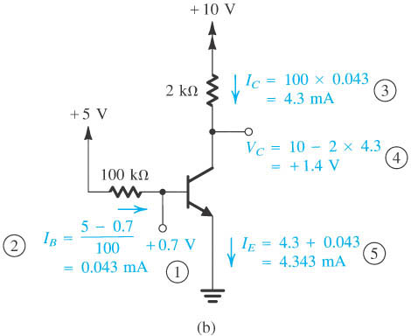
Figure (a) circuit; (b) analysis with the steps indicated by circled numbers. ( β = 100 (active mode) , V_{BE} = 0.7V)
Notes:
sedr42021_0538a.jpg

Slide 26
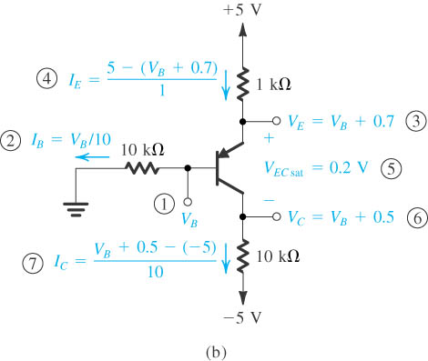
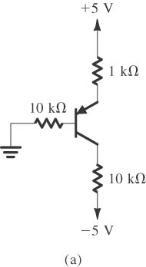
Figure (a) circuit; (b) analysis with the steps indicated by circled numbers. Assume that transistor is in saturation mode and check this assumption (saturation mode: V_{CE} = 0.2V ).
Notes:
sedr42021_0539a.jpg

Slide 27
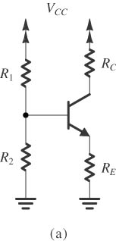
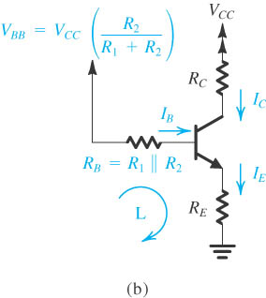
Figure Classical biasing for BJTs using a single power supply: (a) circuit; (b) circuit with the voltage divider supplying the base replaced with its Thévenin equivalent.
Notes:
sedr42021_0544a.jpg

Slide 28
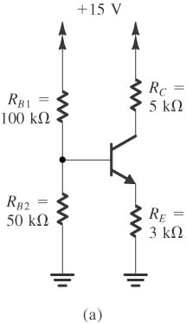
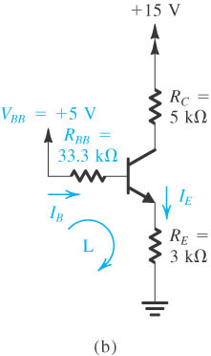
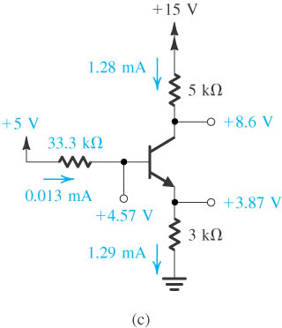
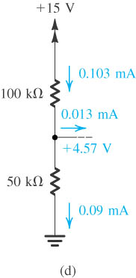
Figure (a) circuit; (b) analysis with the steps indicated by circled numbers.
Notes:
sedr42021_0540a.jpg

Slide 29
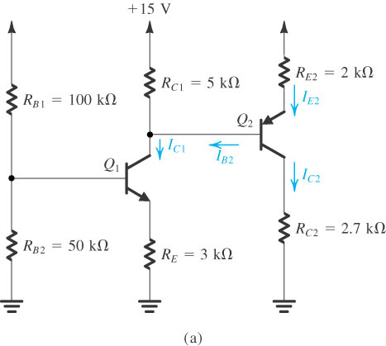
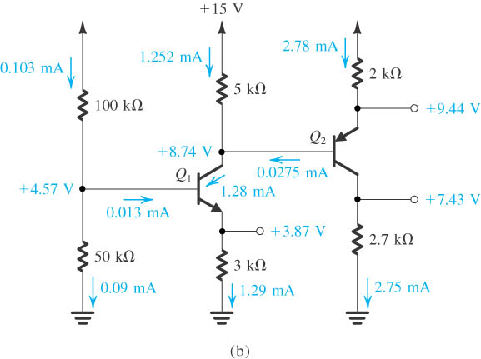
Figure Analyze the circuit ( β = 100 (active mode) , V_{BE} = 0.7V)
Notes:
sedr42021_0541a.jpg

Slide 30
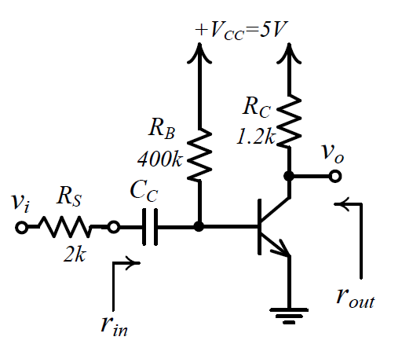
Consider the amplifier shown above. Use the following parameters for your calculations. Transistor parameters : β=200, VBE=0.7V, VT=25mV, VA=100V
a. Find VB and VC of the transistor by performing DC analysis.
b. Find the small signal values of rin, rout, and vout/vin.

Slide 31
Consider an amplifier shown below. Suppose that the value of Cc is high enough, so it can be considered shorted in small signal analysis. Find the small signal values of rin, rout, and vout/vin.
PNP Transistor Parameters: |VBE| = 0.7, β = 100, |VA| = 10V, VT = 25 mV.

Slide 32
Consider an amplifier shown below. Suppose that the value of the coupling capacitors Cc1 and Cc2 are high enough, so they can be considered shorted in small signal analysis. Find the small signal values of rin, rout, and vout/vin.
NPN Transistor Parameters: VBE = 0.7, β = 40, VA = ∞, VT = 25 mV.

Slide 33
For the circuit shown on the left, transistor parameters for identical T₁ and T₂ are V_{A} = ∞, V_{T} = 25 mV, |V_{BE}| = 0,6 V, and h_{fe} = h_{FE} = = β = 100.
a. Determine DC collector currents.
b. Find the small signal voltage gain v_{o}/v_{in}.
c. Determine the input and output resistances.

Slide 34
OPAMP QUESTIONS

Slide 35
Consider the op-amp circuit shown below. Calculate output voltage Vo. Assume the maximum output voltage of the op-amp ranges from – 12V to + 12V.
Answer: 0V

Slide 36
Consider the op-amp circuit shown below. V₁=1V. Calculate output voltage Vo. Assume the maximum output voltage of the op-amp ranges from – 12V to + 12V.
Answer: 4V

Slide 37
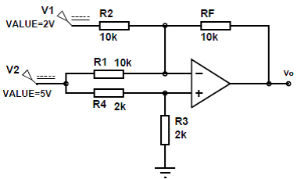
Consider the op-amp circuit shown below. Calculate output voltage Vo. Assume the maximum output voltage of the op-amp ranges from – 12V to + 12V;
Answer: -2V+ (-5V) + 7.5= 0.5V

Slide 38
Consider the op-amp circuit shown below. V₁=2V, V₂=1V. Calculate output voltage Vo. Assume the maximum output voltage of the op-amp ranges from – 12V to + 12V.
Answer: -4.5V-0.5V=-5V

Slide 39
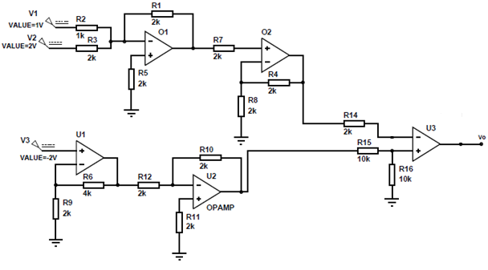
Consider the op-amp circuit shown below. Calculate output voltage Vo. Assume the maximum output voltage of the op-amp ranges from – 12V to + 12V.
Answer:

Slide 40
Consider the op-amp circuit shown below. Calculate output voltage Vo. Assume the maximum output voltage of the op-amp ranges from – 12V to + 12V.
Answer: V1-V2

Slide 41
Consider the op-amp circuit shown below. Calculate output voltage Vo. Assume the maximum output voltage of the op-amp ranges from – 12V to + 12V. All resistors have the sama value 1kΩ.
Answer:

Slide 42
Consider the op-amp circuit shown below. V₁=1V, V₂=2V. Calculate output voltages. Assume the maximum output voltage of the op-amp ranges from – 12V to + 12V.
Answer:

Slide 43
Consider the op-amp circuit shown below. Calculate output voltages. Assume the maximum output voltage of the op-amp ranges from – 12V to + 12V.
Answer:

Slide 44
Consider the op-amp circuit shown below. Calculate output voltages. Assume the maximum output voltage of the op-amp ranges from – 12V to + 12V.
Answer:

Slide 45
Consider the op-amp circuit shown below. Calculate output voltages. Assume the maximum output voltage of the op-amp ranges from – 12V to + 12V.
Answer:

Slide 46
X1(t) and X2(t) are two different input sources. Design a circuit by using Op-Amps that its output exhibits the equation below. Output= X2(t) + 2. X1(t)

Slide 47
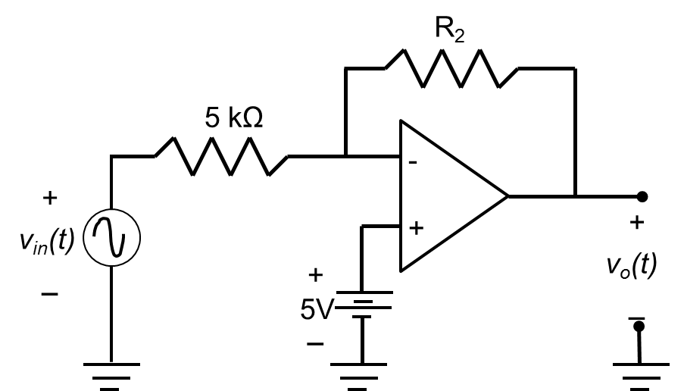
Consider the op-amp circuit shown below. If v_{in}(t)=6+9cos500πt, calculate the value of R2 required to generate a output, vo(t), with zero DC component. What is the resulting output voltage?

Slide 48
Consider the op-amp circuit shown below. Calculate output voltage.
Answer:

Slide 49
Consider the op-amp circuit shown below. Provide values for resistors R1 and R2 that make Vo = −3Vi
Answer:

Slide 50
Consider the op-amp circuit shown below. Calculate output voltages.
Answer:

Slide 51
Consider the following circuit. Assume that the op amp is ideal, except that its output is limited by the power supply to 0 < Vo < 10V.
Answer:

